Slide 1
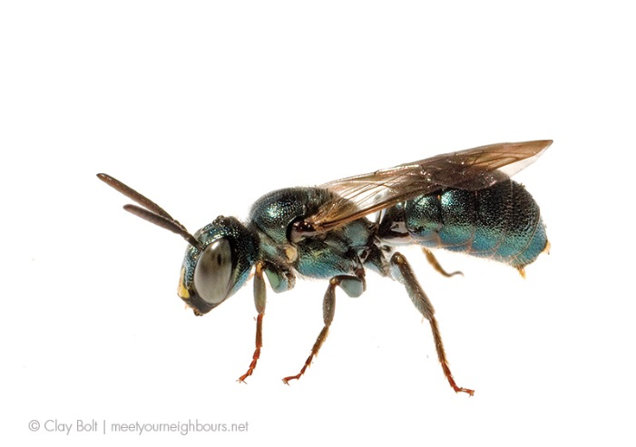
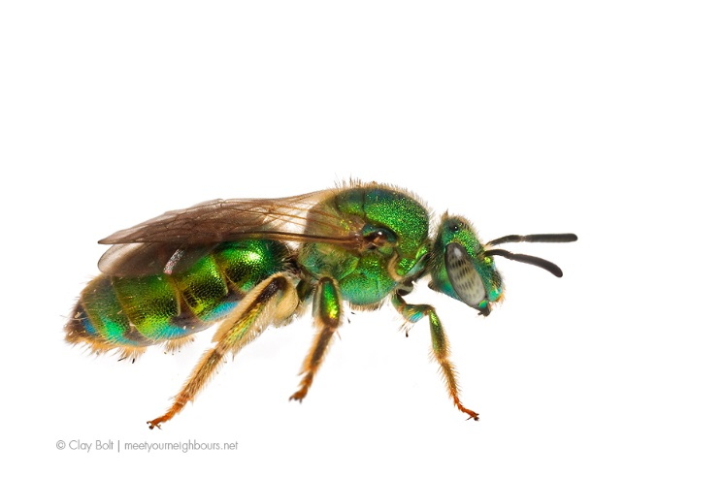
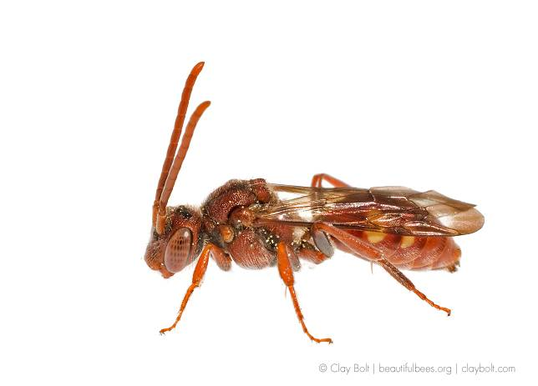
Evaluating bee habitat provisioning in agricultural landscapes
Morgan Mackert
Iowa State University
November 29, 2016

Slide 2
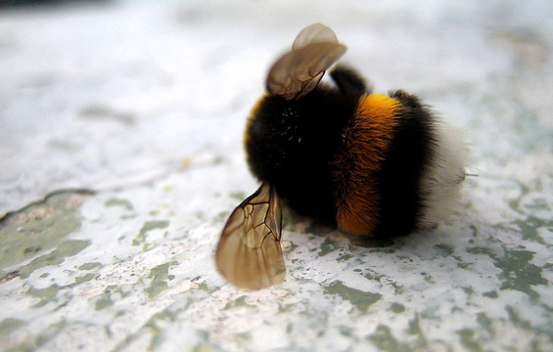
Introduction
Notes:
How many of you have heard that bee populations are declining?

Slide 3
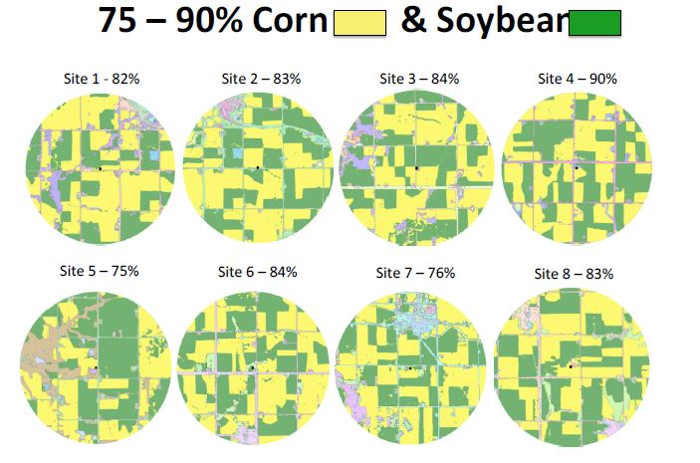
Introduction
Notes:
Arguably, one of the biggest problems facing bees in Iowa and contributing to that decline is that of habitat fragmentation. There is no denying that our landscape is dominated by corn and soybeans, meaning there isn’t much space left for natural or even semi-natural landscapes.

Slide 4
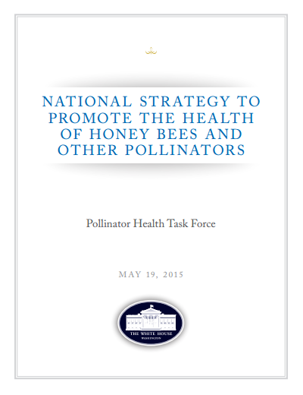
Introduction
Notes:
This issue has even garnered federal attention. In 2015, President Obama issued a memorandum directing a task force to create this strategy in an effort to promote the health of honey bees and other pollinators.

Slide 5
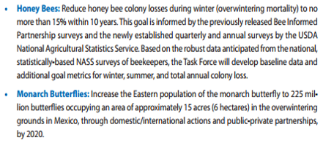
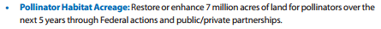
Introduction
Notes:
One of the overarching goals of the resulting strategy was to restore or enhance pollinator habitat acreage.
But is it this easy? Can we just “add pollinator habitat” and expect bees to come bouncing back?

Slide 6
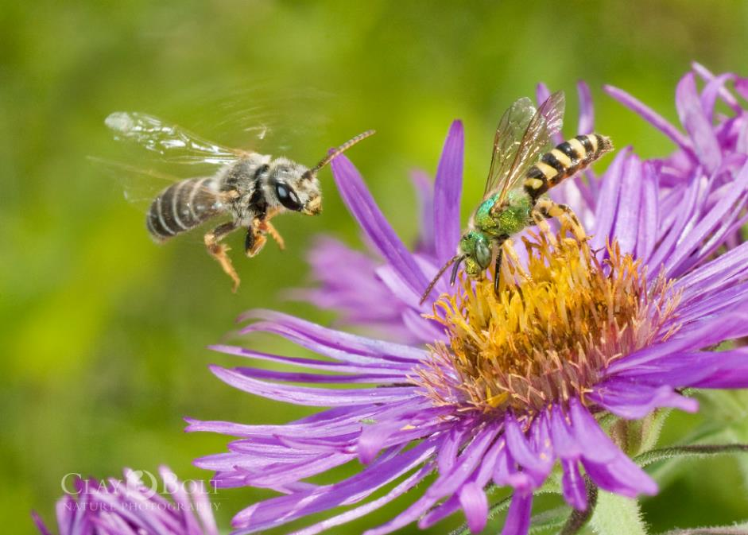
Introduction
How do floral resources influence bee abundance?
Useful in understanding how to maintain bee populations
Notes:
That’s one of the goals of my research: to explore the extent to which floral resources within agricultural systems influence bee abundance.
This research is ultimately useful in understanding how to best maintain bee populations.

Slide 7
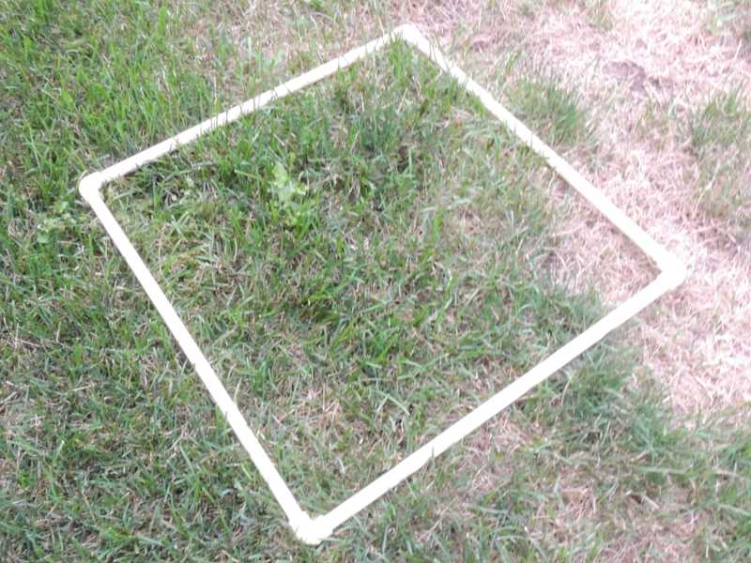
Methods
Notes:
In order to answer this question, we used quadrats to estimate the number of blooming forb species as well as percent cover within the study transects.

Slide 8
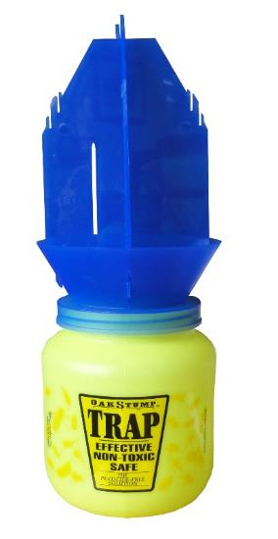
Methods
Notes:
We used a variety of traps to collect bees, the first of which is known as a blue vane trap. We used two blue vane traps per transect.

Slide 9

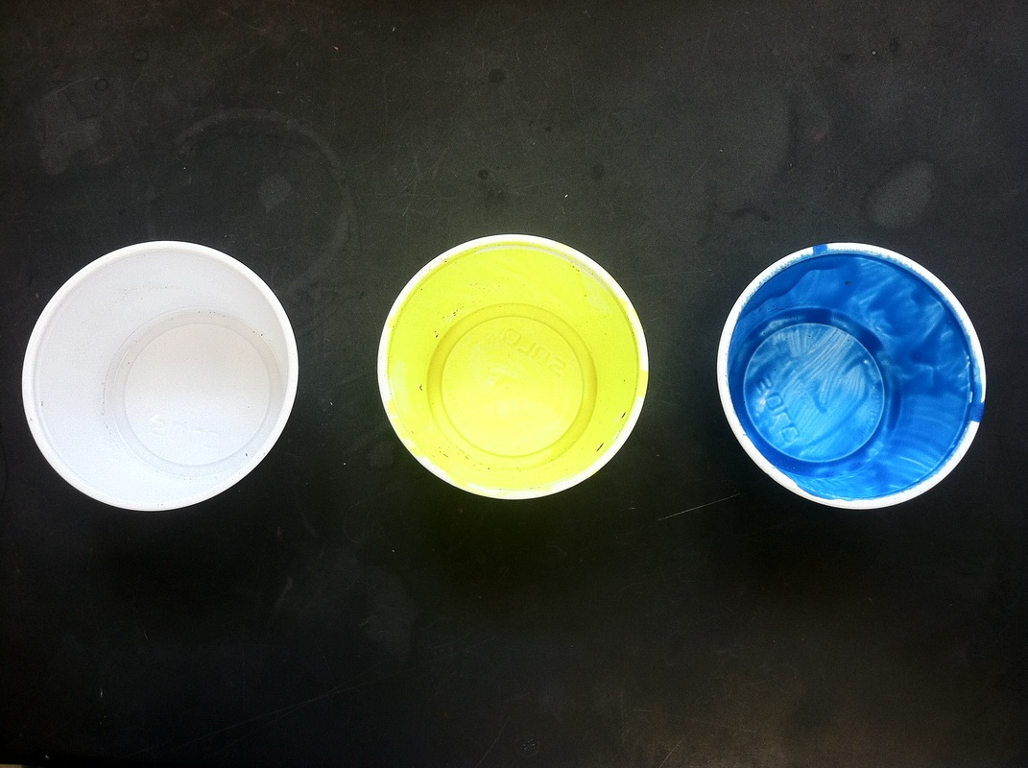
Methods
Notes:
We also used pan traps to collect bees, twelve per transect.

Slide 10
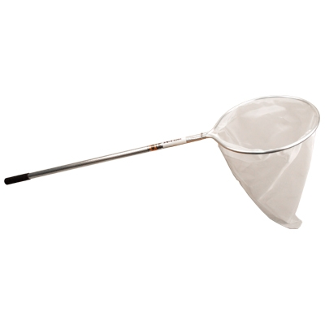
Methods
Notes:
In addition to the stationary traps, we also used nets to collect bees. Following collection, we counted the number of individuals present in each trap type.

Slide 11
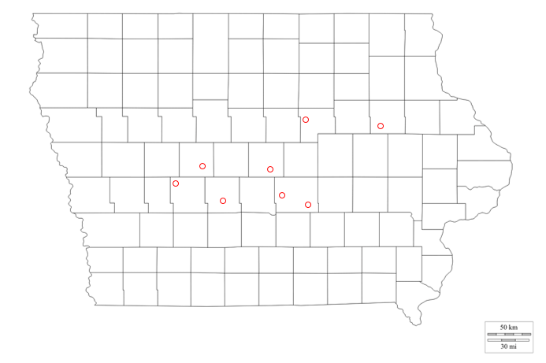
Methods
Predictor: Number of blooming forb species
Response:
Bee abundance
0 – 13 blooming forb species
Notes:
This was done at eight sites throughout Iowa, with each site ranging from 0-13 in the number of blooming forb species present. Considering this, we used the number of blooming forb species present as the predictor to indicate the resulting bee abundance.

Slide 12
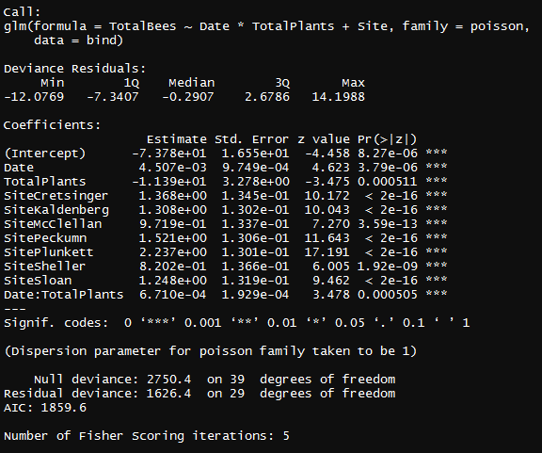
Analysis
glm (bee abundance ~ number of blooming forb species * date + site, family = Poisson)
Notes:
My approach was to be as general as possible. Much of the data I will use is still coming, so I wanted to lay the groundwork and have a model I can manipulate and add to when the rest of my data is compiled. I used a general linear model with bee abundance as the response and number of blooming forb species as the predictor, as I previously mentioned. Based on some preliminary analyses, we determined that date influences number of blooming forb species, and site was considered a fixed effect. There is some serious over-dispersion that I have yet to address, but will in the future.

Slide 13
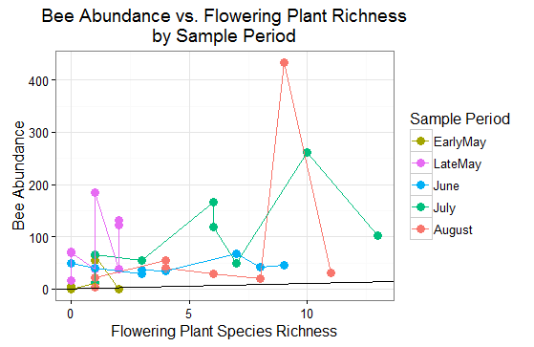
Results
Notes:
And here we have the results. On the x-axis we have the number of flowering plant species and on the y-axis we have number of individual bees collected. The points themselves correspond to each of the eight sites sampled during each sample period, and the different colors denote the sample periods. The best fit line at the bottom has a slightly positive trend.

Slide 14
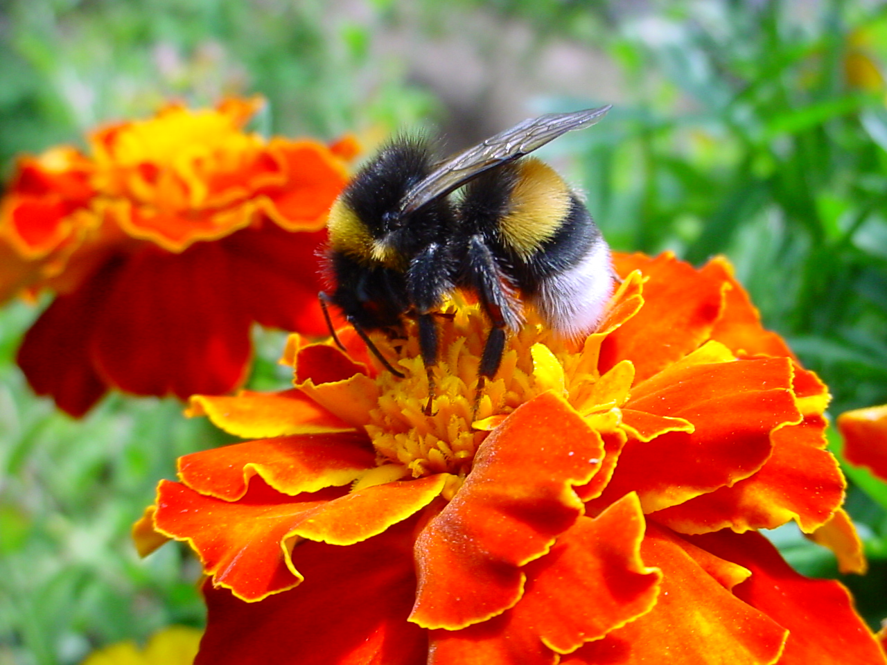
Discussion
Too many variables
Notes:
Because there are likely many other factors at play in the interaction between bees and their environment, at this point I don’t feel comfortable making any definitive claims about what the data means. Moving forward, I should be able to tease out the effects of those other variables. However, with that said, I certainly don’t think it can hurt to plant more flowers!

Slide 15
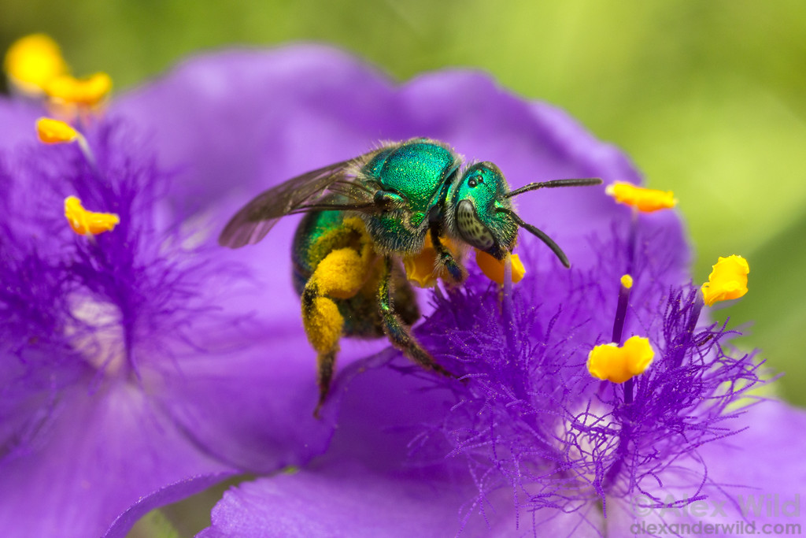
Thank you!
Notes:
Thank you for your attention. I’d really appreciate any feedback or advice that you can offer on how to move forward.

